Slide 1
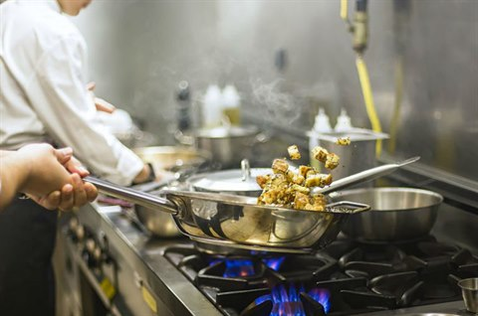
LOCAL GOVERNMENT & FOOD SAFETY

Slide 2
LEGISLATION:
WHY does Council inspect food premises?
To ensure food businesses comply with food safety standards; AND
To protect the health and safety of consumers
The NSW retail food industry is subject to requirements under –
Australia New Zealand Food Standards Code (FSANZ)
Food Act 2003 (NSW)
Food Regulation 2015

Slide 3
FOOD BUSINESS OBLIGATIONS:
Register with Council prior to commencing trade
Ensure foods for sale is both “Safe and Suitable” for human consumption. Definitions from the Food Standards - Unsafe foods: food is unsafe if it would be likely to cause physical harm to a person who might later consume it Unsuitable foods: contains any damaged, deteriorated or perished substance that affects its reasonable intended use, or contains a biological or chemical agent, or other matter or substance, that is foreign to the nature of the food
Prevent misleading conduct in connection with the sale of foods

Slide 4
How often does Council carry out inspections?
Council Environmental Health Officers carry out annual inspections of all retail food premises
Re-inspections are carried out where significant breaches are identified
Additional inspections are also carried out if customer raised concerns with Council
Inspections are conducted unannounced (without prior notice)

Slide 5
INSPECTION OVERVIEW:
Assesses and monitor compliance with the Food Safety Standards and identify any non-compliances requiring action
AN OFFICER WILL CHECK:
Food handlers have appropriate skills and knowledge
Food is being handled in a safe and suitable manner
Whether food that is handled presents a food safety risk, having regard to further food handling or processing e.g. cooking
Whether there is a foreseeable risk of foodborne illness as a consequence of food consumption
Whether the design, construction or food equipment will likely contribute to unsafe foods being produced

Slide 6
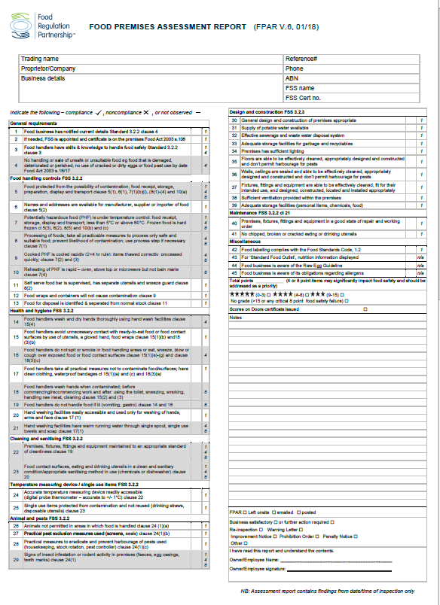
What will be assessed during your inspection?
Inspections are carried out using a standard checklist called the Food Premises Inspection Report (FPAR)
The FPAR features a points system to determine a hygiene and food safety score
A food safety failure will occur if the business scores more than 15 points or any critical (8 point) items are identified

Slide 7
What if you fail your inspection?
An Improvement notice will be issued. A fee of $330 applies
For serious or continuing problems the following enforcement options may be used:
Penalty notices, Prohibition orders, Prosecution
Penalties for food safety breaches include fines of up to $110,000 in the case of an individual, or $550,000 in the case of a corporation. There is also provision for offenders to be imprisoned for up to 2 years for very serious offences
Anyone who is served with a penalty notice or prosecuted will also be named on the Food Authority’s ‘Name and Shame’ Register

Slide 8
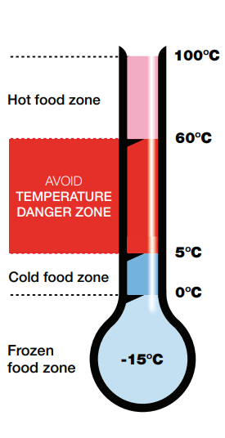
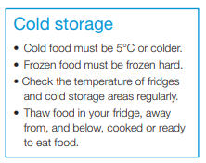
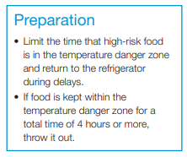
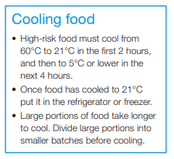
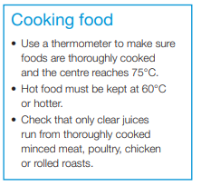
TEMPERATURE - Food Safety Controls:

Slide 9
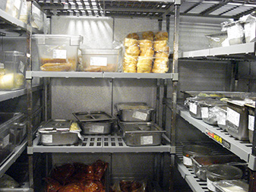
FOOD STORAGE - Food Safety Controls:
Foods are covered and protected from contamination risk during storage
Store raw foods such as raw meat and seafood on the bottom shelf and ready-to eat food above raw foods
Do not store food directly on floor.
Do not overstock cool room
Do not try to cool large volumes of food all at once. Portion foods into smaller volumes for rapid cooling

Slide 10
FOOD HANDLING – Protection from contamination:
Separate utensils and equipment for raw foods vs ready to eat foods
Sanitise utensils and food processing equipment effectively after use
Minimise unnecessary contact with ready-to-eat food and changing disposable gloves between tasks and discarding after use

Slide 11
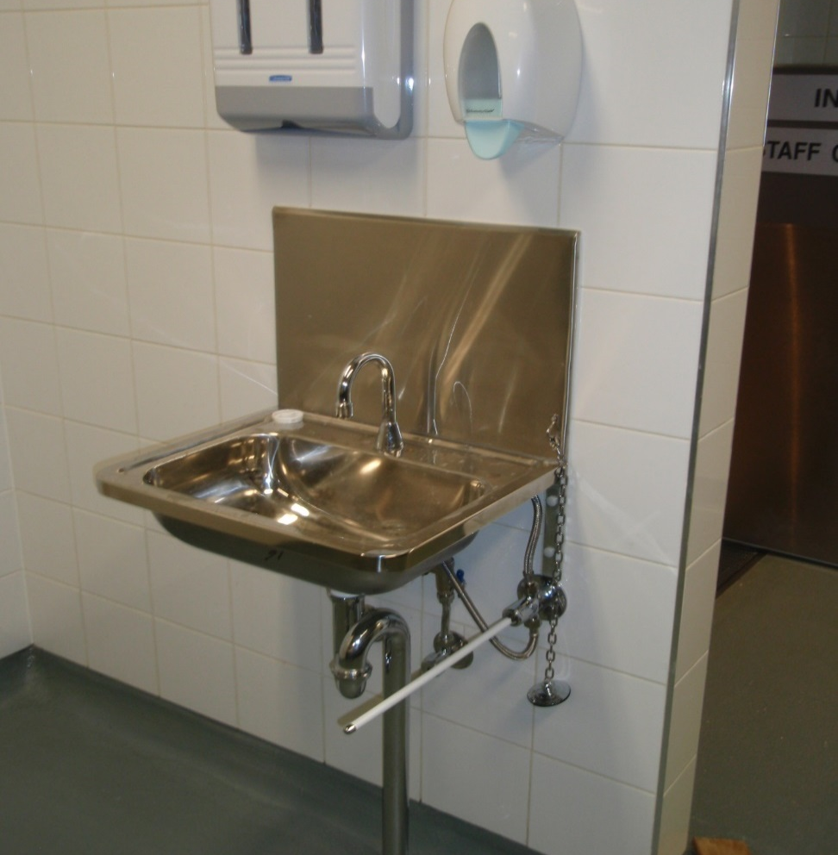
HAND HYGIENE - Food Safety Controls:
Easily accessible for food handlers to routinely wash hands.
Hand basins have warm running water, soap and paper towel
Hands washed after changing activity or touching money, hair, face or immediately after the toilet.

Slide 12
HEALTH AND HYGIENE - Food Safety Controls:
Sick or ill staff must stay home
Washing of hands routinely and between activities or returning to work after a break
Do not eat, drink or smoke when in the kitchen or handling food
Change food handling gloves regularly and after handling raw foods

Slide 13
CLEAING & SANITISING – Food Safety Control.
Cleaning and sanitising are separate procedures. Definitions from the Food Standards Code - Cleaning: “A process that removes visible contamination such as food waste, dirt and grease from a surface, usually using water and detergent” Sanitising: “A process that destroys microorganisms, reducing the numbers present on a surface to a safe level” NOTE. Best practice is to apply a chemical sanitiser, only after thorough cleaning

Slide 14
DESIGN CONSTRUCTION & PESTS - Food Safety Controls:
The design, construction and equipment must be appropriate for the intended use and facilitate easy cleaning
Poor design, construction or build quality commonly results in poor cleaning and increased food contamination risks for inadequate space to prepare foods safely
Must take all practicable measures to prevent pests entering the food premises
Take all practicable measures to eradicate and prevent the harbourage of pests

Slide 15
WASTE MANAGEMENT- Food Safety Controls:
Poor waste management can impact food safety
The waste containers should be stored wholly on your premises – preferably in a properly constructed garbage room or covered waste storage area
Make sure you have adequate bins and service frequencies
Bins left on public land can block access and will incur a fine

Slide 16
SPECIALISED FOODS – Raw Egg products:
Significant contributor to foodborne illness in AUS / NSW
Salmonella present on the surfaces of eggs and improper handling or cross contamination can lead to foodborne illness
Raw eggs used for sauces or desserts. Substitute with pasteurised eggs or commercially produced products
Salmonella destroyed by heat treatment (cooking) or acidification. Compliance with raw egg guidelines
.

Slide 17
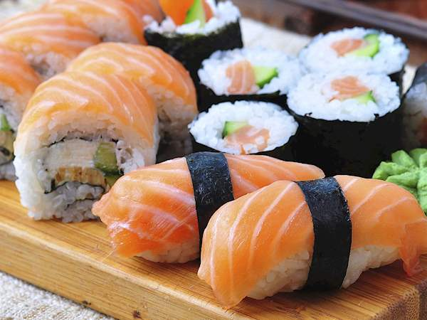
SPECIALISED FOODS – Sushi:
Prepared in accordance with the Food Safety Guidelines for Sushi
Acidify sushi rice to a pH of 4.6
Once acidified, rice must be stored covered and can be stored up to 8 hours before disposal
Sushi can be displayed at room temperature for up to 4 hours and then must be discarded

Slide 18
SPECIALISED FOODS - Traditional BBQ products:
Traditionally prepared BBQ pork, duck and chicken are safe to display at room temperature on the day of preparation until they are cut
Once cut, the meat must be discarded after 4 hours
Records or a documented system should be in place to demonstrate food safety compliance e.g. 4 hour food safety rule

Slide 19
FOOD LABELLING:
Packaged foods must comply with the Food Standards Code
Labels must be in English
Mandatory declarations (Allergens) incl. nuts, dairy, eggs, gluten
Prohibition of sale past the “Use-by Date”
Certain exemptions apply, food prepared and packaged on the premises

Slide 20
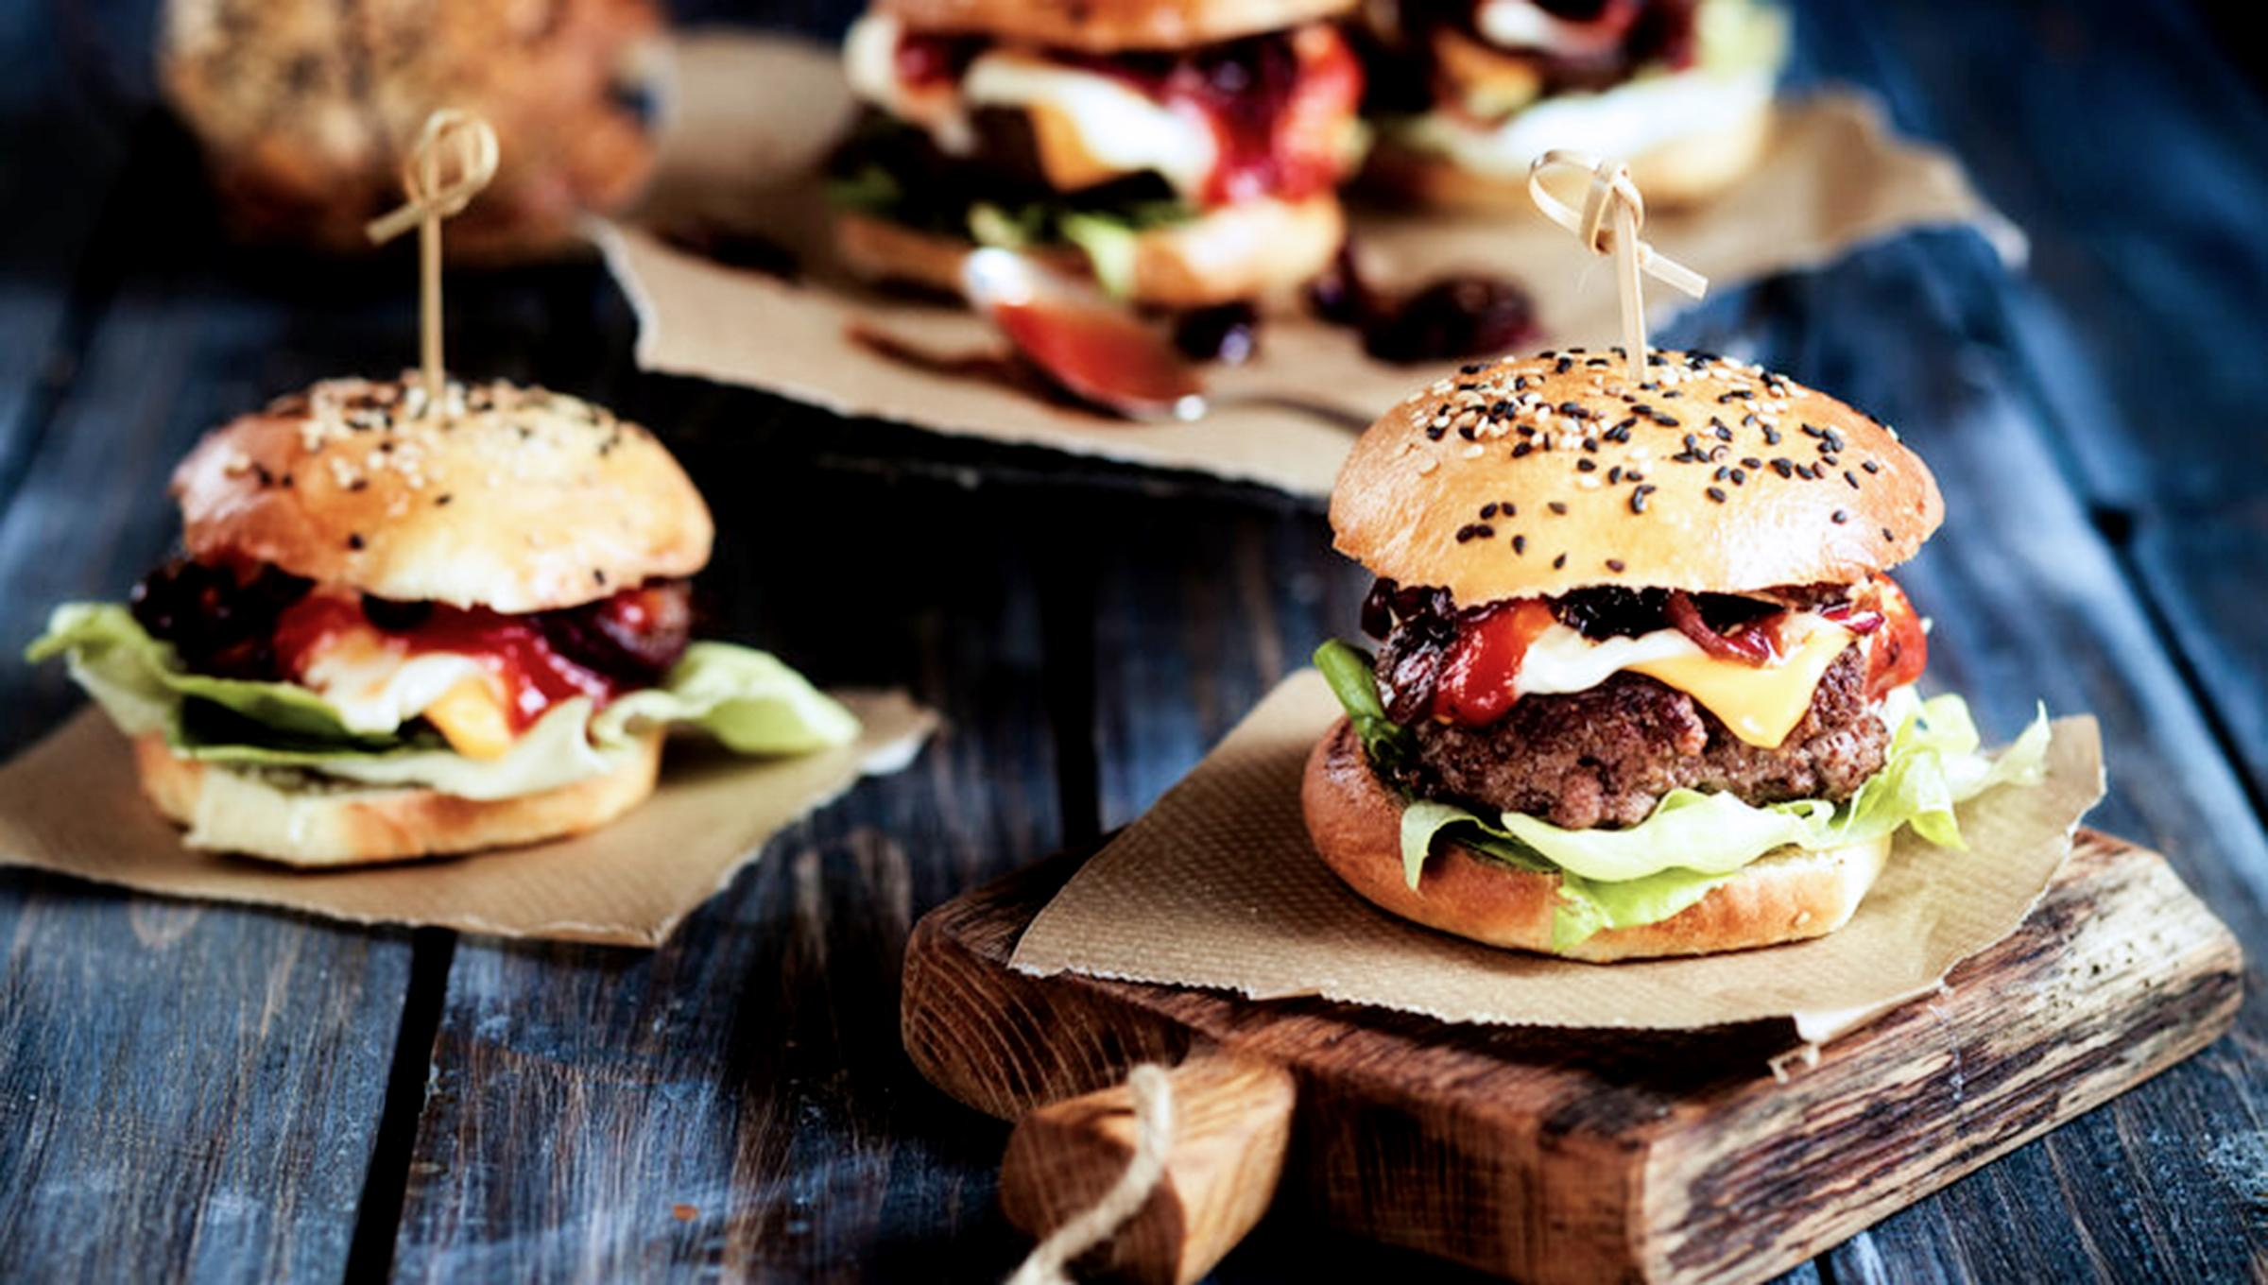
Improving Inspection Compliance.
For more information or advice, please contact Council’s Environmental Health Team on 9952 8222 or cityofryde@ryde.nsw.gov.au. Or alternatively, visit our website on

